Slide 1
APPLIED DATA SCIENCE GROUP-2
PROJECT 9:
AIR QUALITY ANALYSIS AND PREDICTION IN TAMILNADU

Slide 2


Slide 3
Public view for problem
The objective of this project is to analyze and visualize air quality data from various monitoring stations in Tamil Nadu.
The dataset contains measurements of Sulfur Dioxide (SO2), Nitrogen Dioxide (NO2), and Respirable Suspended Particulate Matter/Particulate Matter 10 (RSPM/PM10) levels in different cities, towns, villages, and areas.
The project aims to gain insights into the air pollution trends, identify areas with high pollution levels, and create a predictive model to estimate RSPM/PM10 levels based on SO2 and NO2 levels.

Slide 4
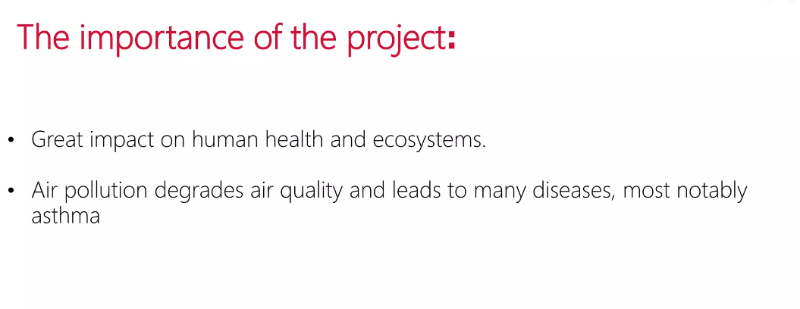
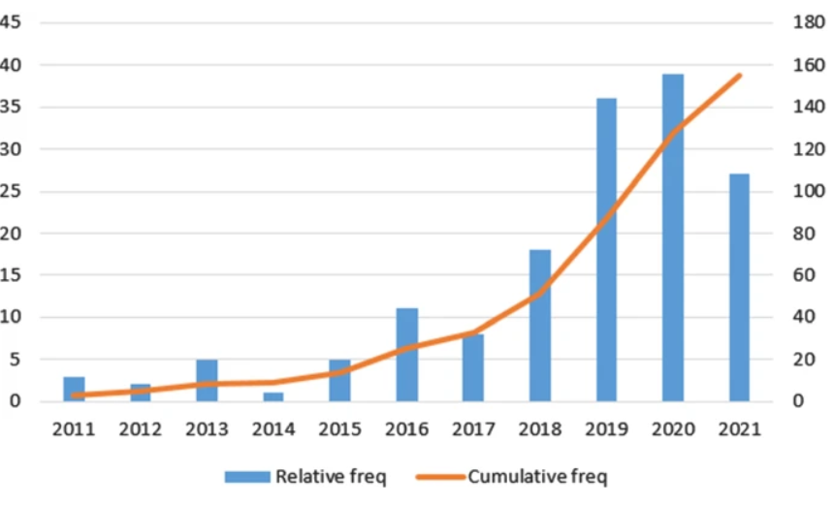

Slide 5
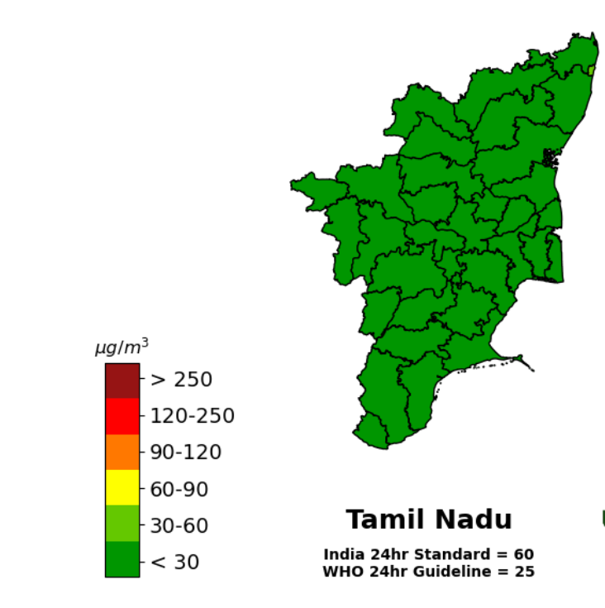
The Goal of the research
Project Objectives:
Define objectives such as analyzing air quality trends, identifying pollution hotspots, and building a predictive model for RSPM/PM10 levels.
Analysis Approach:
Plan the steps to load, preprocess, analyze, and visualize the air quality data.
Visualization Selection:
Determine visualization techniques (e.g., line charts, heatmaps) to effectively represent air quality trends and pollution levels.

Slide 6
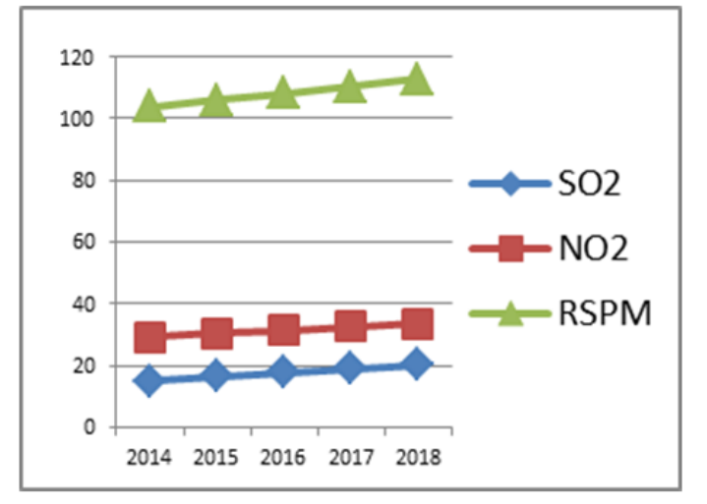
Methods used to predict
Chemical transport model(CTMs)
Statistical model
Weather model
Time series analysis
Ensemble model

Slide 7
Python code
import pandas as pd import numpy as np from sklearn.model_selection import train_test_split from sklearn.linear_model import LinearRegression import matplotlib.pyplot as plt np.random.seed(0) dates = pd.date_range(start="2014-01-01", end="2014-12-31", freq="D") pm10_levels = np.random.randint(10, 100, len(dates)) temperature = np.random.randint(25, 35, len(dates)) humidity = np.random.randint(40, 70, len(dates))
data = pd.DataFrame({"Date": dates, "PM10": pm10_levels, "Temperature": temperature, "Humidity": humidity})

Slide 8
X = data[["Temperature", "Humidity"]] y = data["PM10"] X_train, X_test, y_train, y_test = train_test_split(X, y, test_size=0.2, random_state=42)
model = LinearRegression() model.fit(X_train, y_train) y_pred = model.predict(X_test) from sklearn.metrics import mean_squared_error, r2_score mse = mean_squared_error(y_test, y_pred) r2 = r2_score(y_test, y_pred) print("Mean Squared Error:", mse) print("R-squared:", r2) plt.scatter(y_test, y_pred)
plt.xlabel("Actual PM10 Levels") plt.ylabel("Predicted PM10 Levels") plt.title("Actual vs. Predicted PM10 Levels") plt.show()

Slide 9
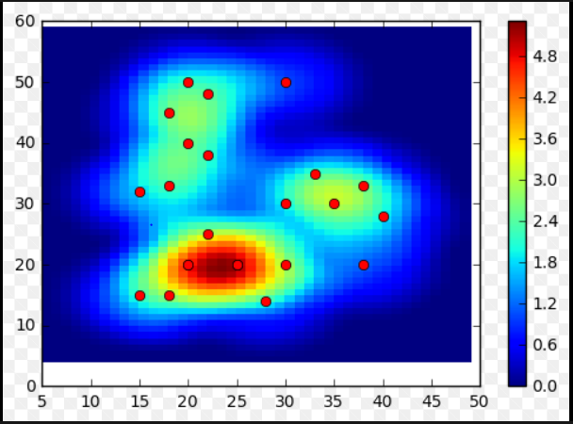
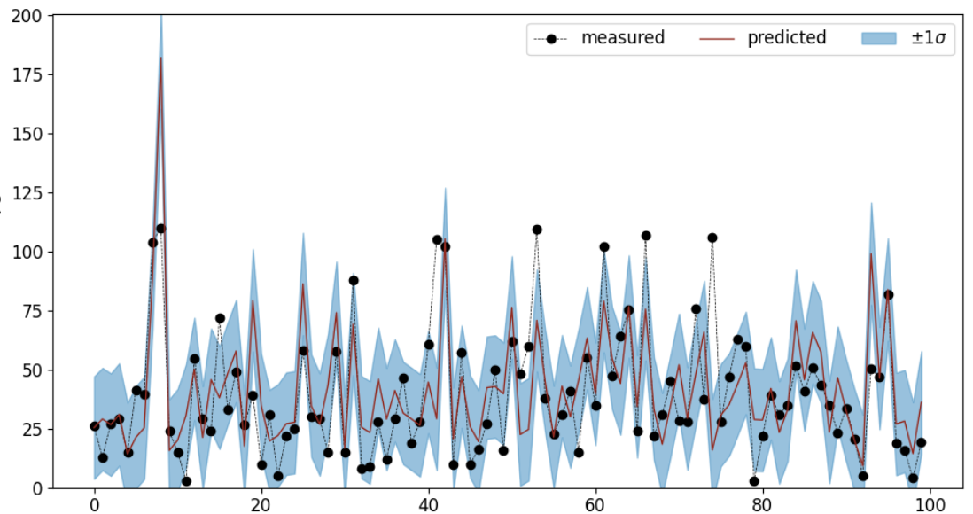
Result and Conclusion

